Slide 1
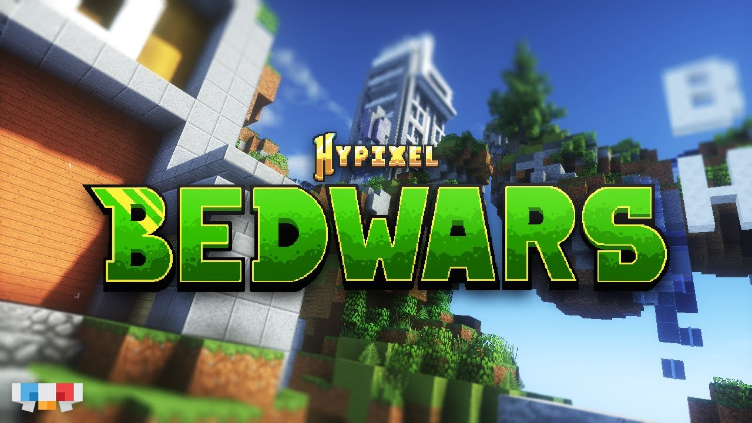

Slide 2
What is Bedwars
A popular mini-game in Minecraft, usually played multiplayer
Objective: Protect your bed, gear up and eliminate other teams
Lose your bed = no more respawning!
Win by being the last team standing

Slide 3


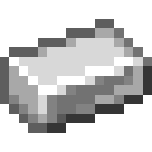
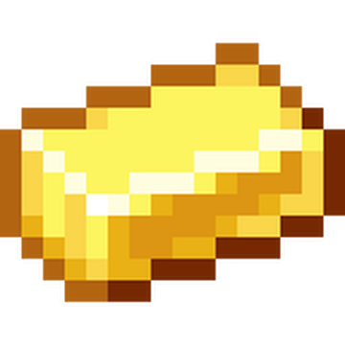
The Four Currencies
Basic Necessities
Stronger Items
Base Upgrades
Strongest Items

Slide 4
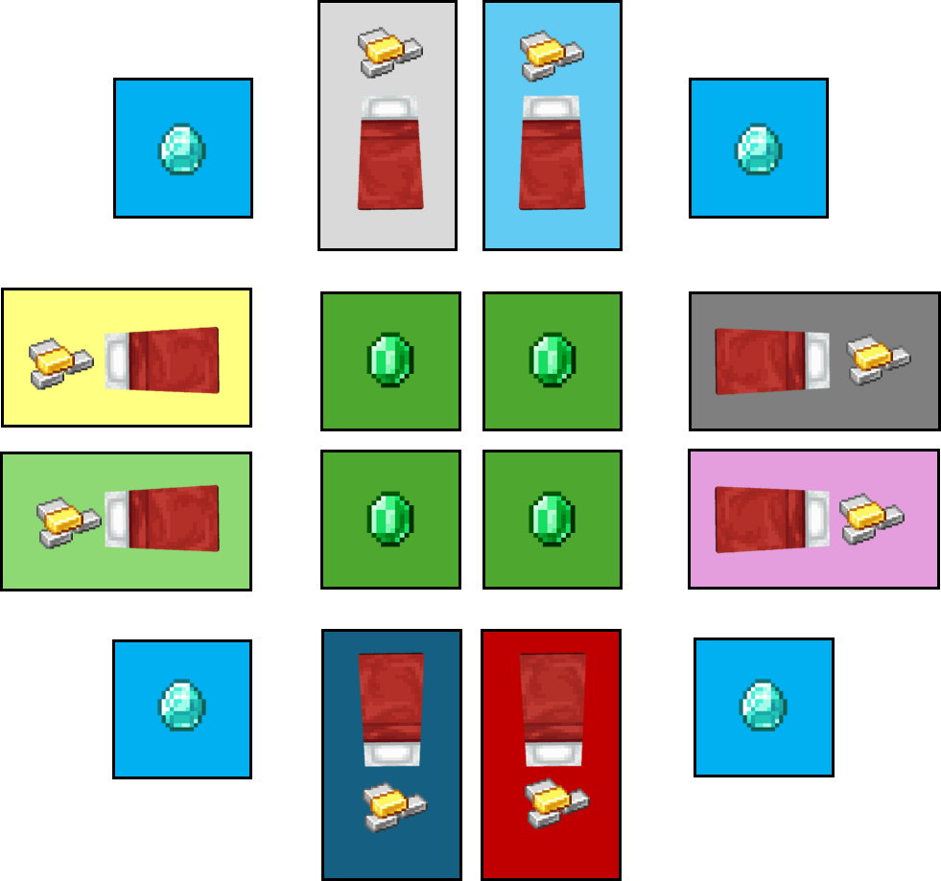

Slide 5
Typical Game
Build basic bed defense
Attack neighbors
Collect resources
Slowly strengthen defense and eliminate players

Slide 6
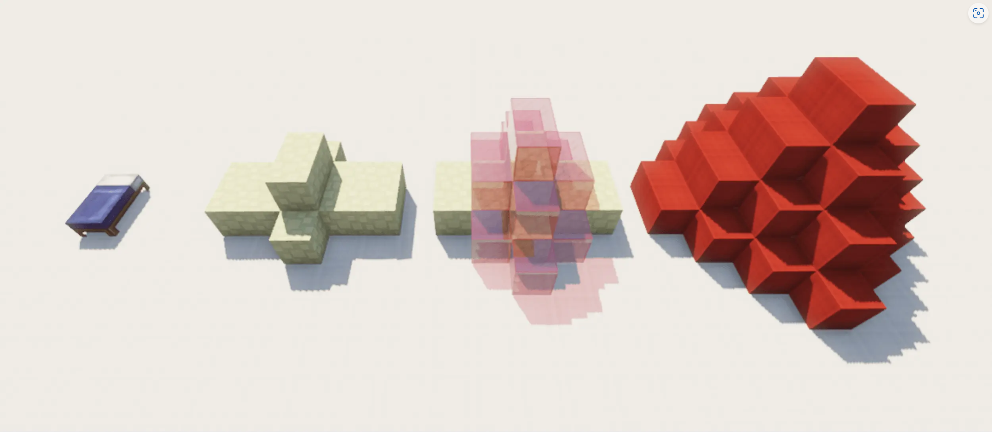
Bed Defense

Slide 7
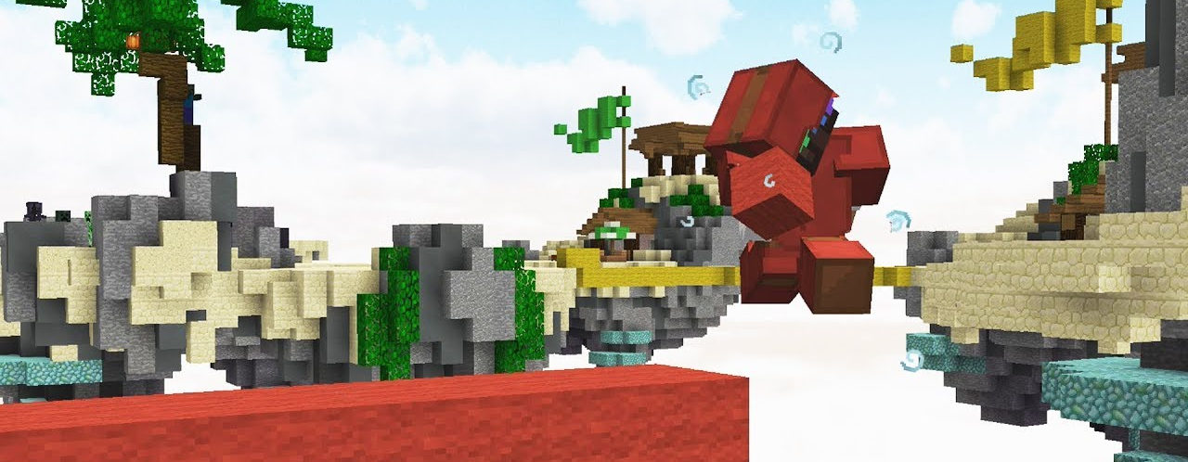
Bridging

Slide 8
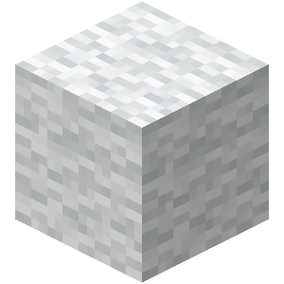
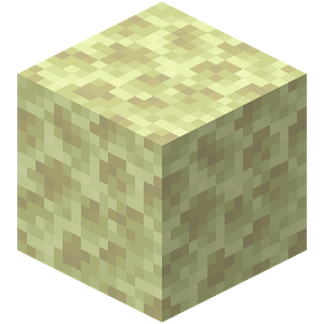
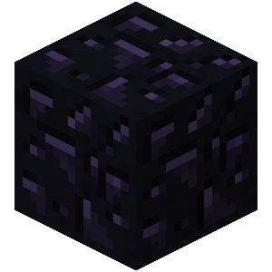
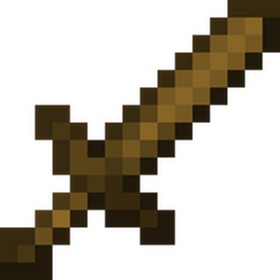
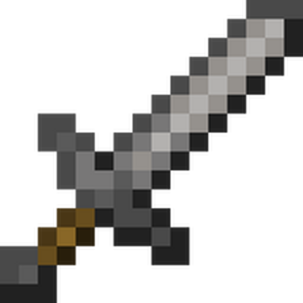
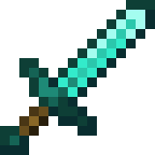
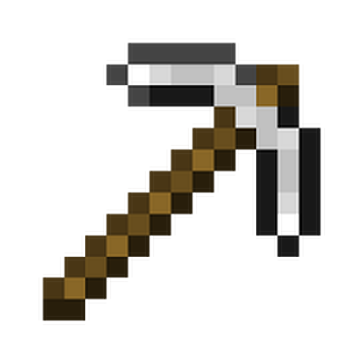
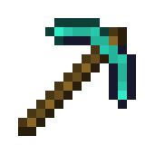

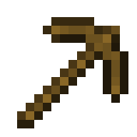
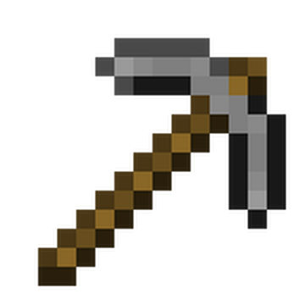
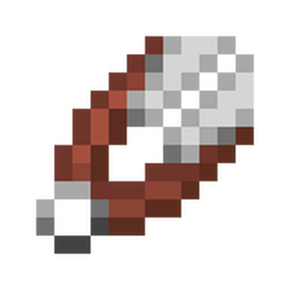
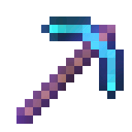

Items we added

Slide 9
Our Approach
Types of players:
Aggressive
Defensive
Resourceful
Optimal

Slide 10
Combat System
Players are seeded with bridging skill and fighting skill
Bridging allows players to traverse between islands quickly
Critical hit priority for fights on bridging
Players with higher combat rating have an increased hit chance
Based on the hits one player survives and one dies

Slide 11
Simulation Approach
Created a custom game engine for the simulating matches
Implemented a tick system to run per micro-action
Each player picks a certain micro-action as part of a broad plan to win

Slide 12
AI Approach
Minimax Algorithm with Alpha-Beta Pruning
Expectimax
Heuristic Evaluation Function
Goal-Oriented Action Planning
Breadth-First Search (BFS)
Dynamic Decision Making
Goal Stickiness Mechanism

Slide 13
Results
Initially:
When the optimal agent has advantage in any skill it destroys the others
The resourceful agent is good at playing the long game
The optimal agent makes detailed plans but runs out of time to execute them
The aggressive can catch players by surprise
After teaching the optimal agent to weakness the other playstyles weakness:
The opt

Slide 14
Next Steps
Add more items to incentivize diversity in strategy
Add various map formats to see how it changes player navigation
Add team matches to see how AI agents can collaborate together
More realistic timing for matches
Add sudden death mode

